Slide 1

ADOPTION OF DRIP IRRIGATION
Decision Analysis and Forecasting in Agriculture
Steven Kiwewesi, Adrien Knobloch, Silas Oyieyo, Sri Aparna

Slide 2
Introduction
Decision- Drip Irrigation adoption in Kenya Irrigation schemes.
Why that Decision- Due to Climate change effects especially the increased events of drought conditions in Kenya, there is a need for proper management and utilisation of water resources. Surface irrigation system comprises the biggest percentage in Kenya Irrigation Schemes thus drawing a lot of water from the landscape. Therefore we want the government of Kenya to buy into the idea of Drip Irrigation as a sustainable water management approach in the various Irrigation Schemes.
Decision Makers- Government of Kenya will be the Decision Makers who also do stakeholder analysis.

Slide 3
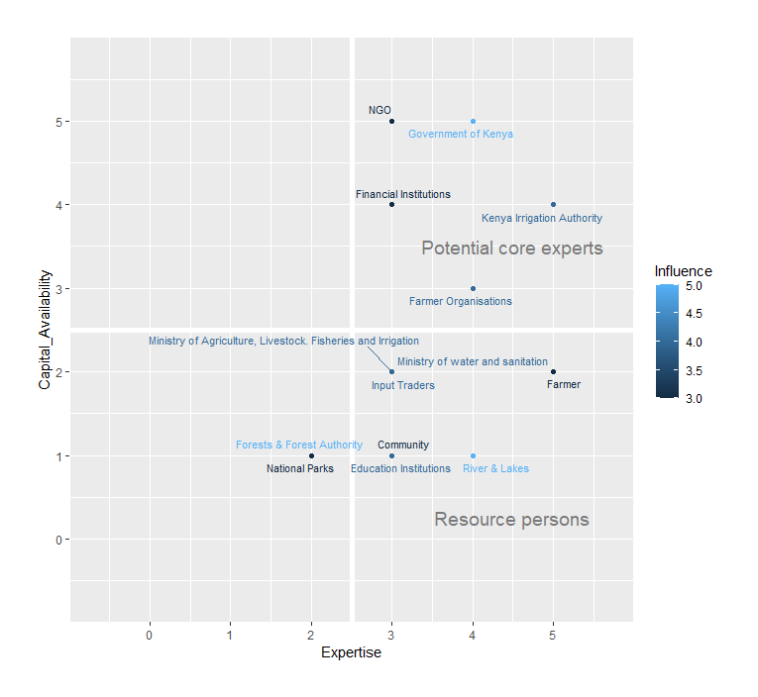
Stakeholder Analysis
Individual/group who has interests/can affect/ is affected by the decision
After brainstorming and with the help of the STRATEGIC PLAN (2019-2023) by National Irrigation Authority, decided to work on 14 stakeholders
For each of them, defined :
Roles
Major one
Rated :
Capital availability
Influence
Expertise
Conclusion : Government, NGO, irrigation authority = most important (as expected)
It confirms our choice to work with the Government as thew decision maker

Slide 4
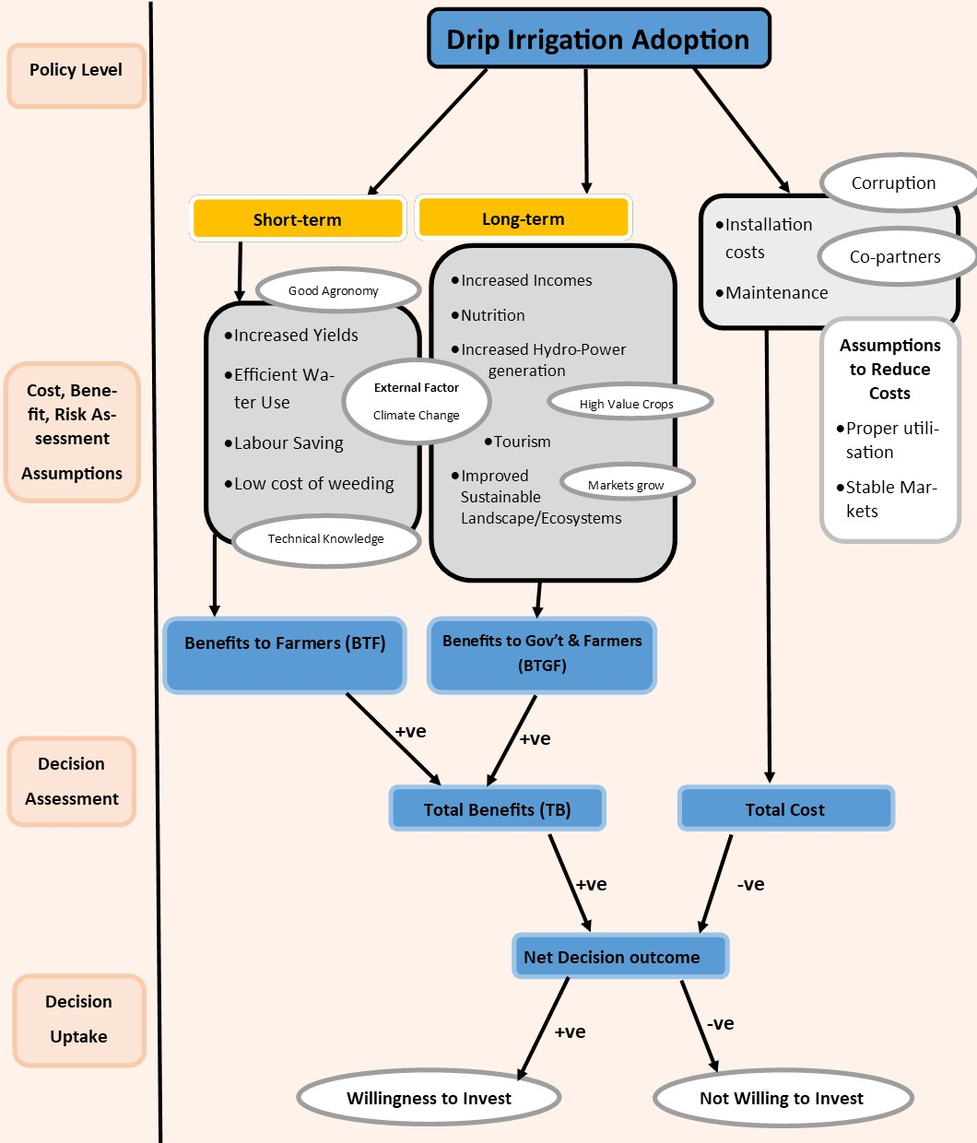
Conceptual Model
What Next?
We hope to come up with estimate data that will give value to the uncertainties linked to our project using McSimulation.
Building the model with Plot of the impact pathway and calibration of the data will consequentially take place.

